Slide 1

Lectures 8 Functions
PROGRAMMING 1
(CS 102)
8
Fall (2025-2026)

Slide 2
Course Learning Objectives
Explain and define fundamental programming concepts, including variables, data types, the sequential nature of program execution, and basic program input/output (I/O).
Trace and debug simple programs to identify and correct basic syntax and logical errors.
Apply basic programing concepts, such as conditional statements, loops, and functions, to solve small scale computational problems.
Decompose problems into smaller, manageable subroutines, and implement basic functions to enhance code modularity and reusability.
Collaborate with peers Work in a team to design and implement a software project that meets specific functional requirements.

Slide 3
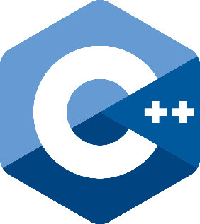
Lecture 8 : Functions
Content
Predefined Functions
Programmer-defined Functions

Slide 4

1.Predefined Functions

Slide 5
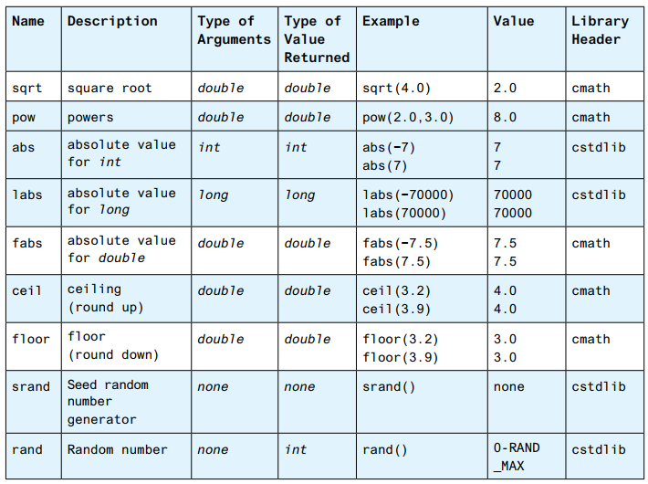
Predefined Functions
C++ comes with libraries of predefined functions that you can use in your programs.
Using #include to include a library, for example:
#include <cmath>
You can see more predefined functions.

Slide 6
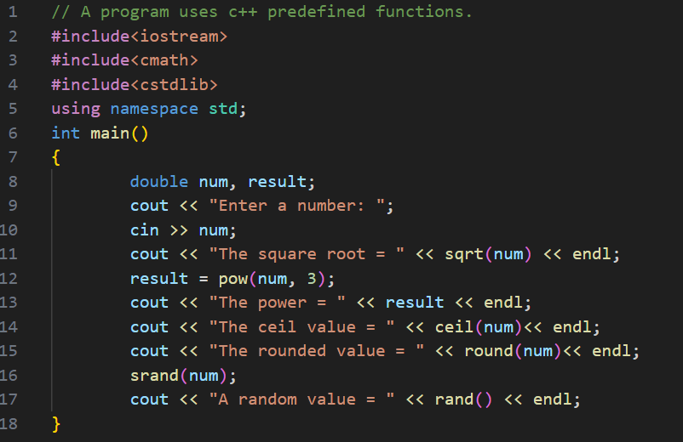
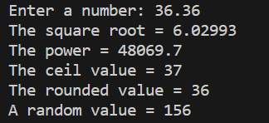
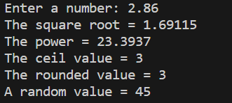
C++ Libraries
Predefined Functions

Slide 7
2. Programmer-defined Functions

Slide 8
C++ Functions
A function is a block of code which only runs when it is called.
You can pass data, known as parameters, into a function.
Functions are used to perform certain actions, and they are important for reusing code:
      Define the code once, and use it many times.

Slide 9
Create a Function
Create your own functions to perform certain actions.
To create (often referred to as declare) a function, specify the name of the function, followed by parentheses ():
myFunction() is the name of the function.
void means that the function does not have a return value.
return type must be added before function name. ( void, int , double , ………)
void myFunction() {
// code to be executed
}

Slide 10
Function Declaration and Definition
A C++ function consist of two parts:
Declaration: the return type, the name of the function, and parameters (if any)
Definition: the body of the function (code to be executed)
void myFunction(parameter1, parameter2,……) { // declaration
// the body of the function (definition)
}
Note: If a user-defined function, such as myFunction() is declared after the main() function, an error will occur:

Slide 11
Call a Function
Declared functions are not executed immediately. They are "saved for later use", and will be executed later, when they are called.
To call a function, write the function's name followed by two parentheses () and a semicolon ; in the main() function

Slide 12
Call a Function
In the following example, myFunction() is used to print a text , when it is called.
Example: Inside main, call myFunction():
// Create a function
void myFunction() {
cout << "I just got executed!";
}
int main() {
myFunction(); // call the function
return 0;
}
// Outputs
I just got executed!

Slide 13
C++ The Return Keyword
The void keyword, indicates that the function should not return a value.
If you want the function to return a value, you can use a data type (such as int, string, etc.) instead of void, and use the return keyword inside the function:
int myFunction(int x) {
return 5 + x;
}
int main() {
cout << myFunction(3);
return 0;
}
// Outputs 8 (5 + 3)

Slide 14
Opening Problem (Function Idea)
What does this program do?
int main()
{
int sum = 0;
for (int i = 1; i <= 10; i++)
sum += i;
cout << "Sum from 1 to 10 is " << sum << endl;
sum = 0;
for (int i = 20; i <= 37; i++)
sum += i;
cout << "Sum from 20 to 37 is " << sum << endl;
sum = 0;
for (int i = 35; i <= 49; i++)
sum += i;
cout << "Sum from 35 to 49 is " << sum << endl;
return 0;
}
Notes:
Find the sum of integers from 1 to 10, from 20 to 37, and from 35 to 49, respectively.

Slide 15
An Alternative
int sum(int i1, int i2)
{
int sum = 0;
for (int i = i1; i <= i2; i++)
sum += i;
return sum;
}
int main()
{
cout << "Sum from 1 to 10 is " << sum(1, 10) << endl;
cout << "Sum from 20 to 37 is " << sum(20, 37) << endl;
cout << "Sum from 35 to 49 is " << sum(35, 49) << endl;
return 0;
}
Function Definition
(Define a Function)
Function Call
(Invoke a function)

Slide 16
An Alternative
Return value type
Method name
int sum(int i1, int i2)
{
int sum = 0;
for (int i = i1; i <= i2; i++)
sum += i;
return sum;
}
int main()
{
cout << "Sum from 1 to 10 is " << sum(1, 10) << endl;
cout << "Sum from 20 to 37 is " << sum(20, 37) << endl;
cout << "Sum from 35 to 49 is " << sum(35, 49) << endl;
return 0;
}
Parameters List
Return value

Slide 17
An Alternative
Function signature
Function header
int sum(int i1, int i2)
{
int sum = 0;
for (int i = i1; i <= i2; i++)
sum += i;
return sum;
}
int main()
{
cout << "Sum from 1 to 10 is " << sum(1, 10) << endl;
cout << "Sum from 20 to 37 is " << sum(20, 37) << endl;
cout << "Sum from 35 to 49 is " << sum(35, 49) << endl;
return 0;
}
Function body

Slide 18
Function Declaration(Two Options)
Function Prototype
int max(int num1, int num2)
{
int result;
if (num1 > num2)
result = num1;
else
result = num2;
return result;
}
int main()
{
int i = 5;
int j = 2;
int k = max(i, j);
}
int max(int num1, int num2);
int main()
{
int i = 5;
int j = 2;
int k = max(i, j);
}
int max(int num1, int num2)
{
int result;
if (num1 > num2)
result = num1;
else
result = num2;
return result;
}
Function Declaration
Function Declaration

Slide 19
Overloading Functions
With function overloading, multiple functions can have the same name with different parameters ( data type or number of parameters ):
int myFunction(int x)
float myFunction(float x)
double myFunction(double x, double y)

Slide 20
Overloading Functions
The max function works for int data type.
What if you also need double numbers?
// Return the max of two int values
int max(int num1, int num2) {
if (num1 > num2)
return num1;
else
return num2;
}
// Find the max of two double values
double max(double num1, double num2) {
if (num1 > num2)
return num1;
else
return num2;
}
int main()
{
// call the max with int parameters
cout << "The maximum of 3 and 4 is "
<< max(3, 4) << endl;
// call the max with the double parameters
cout << "The maximum of 3.0 and 5.4 is "
<< max(3.0, 5.4) << endl;
return 0;
}

Slide 21
Ambiguous Invocation
int maxNumber(int num1, double num2)
{
if (num1 > num2)
return num1;
else
return num2;
}
double maxNumber(double num1, int num2)
{
if (num1 > num2)
return num1;
else
return num2;
}
int main()
{
cout << maxNumber(1, 2) << endl;
return 0;
}
Ambiguous invocation is a compilation error.
Notes:
Ambiguous غامض

Slide 22

Pass by Value
Write a program for swapping two variables.
void swap(int n1, int n2)
{
int temp = n1;
n1 = n2;
n2 = temp;
}
The values of the arguments are not changed after the function is invoked.
int main()
{
int num1 = 1;
int num2 = 2;
swap(num1, num2);
cout << "After invoking the swap function, num1 is "
<< num1 << " and num2 is " << num2 << endl;
return 0;
}
After invoking the swap function, num1 is 1 and num2 is 2

Slide 23
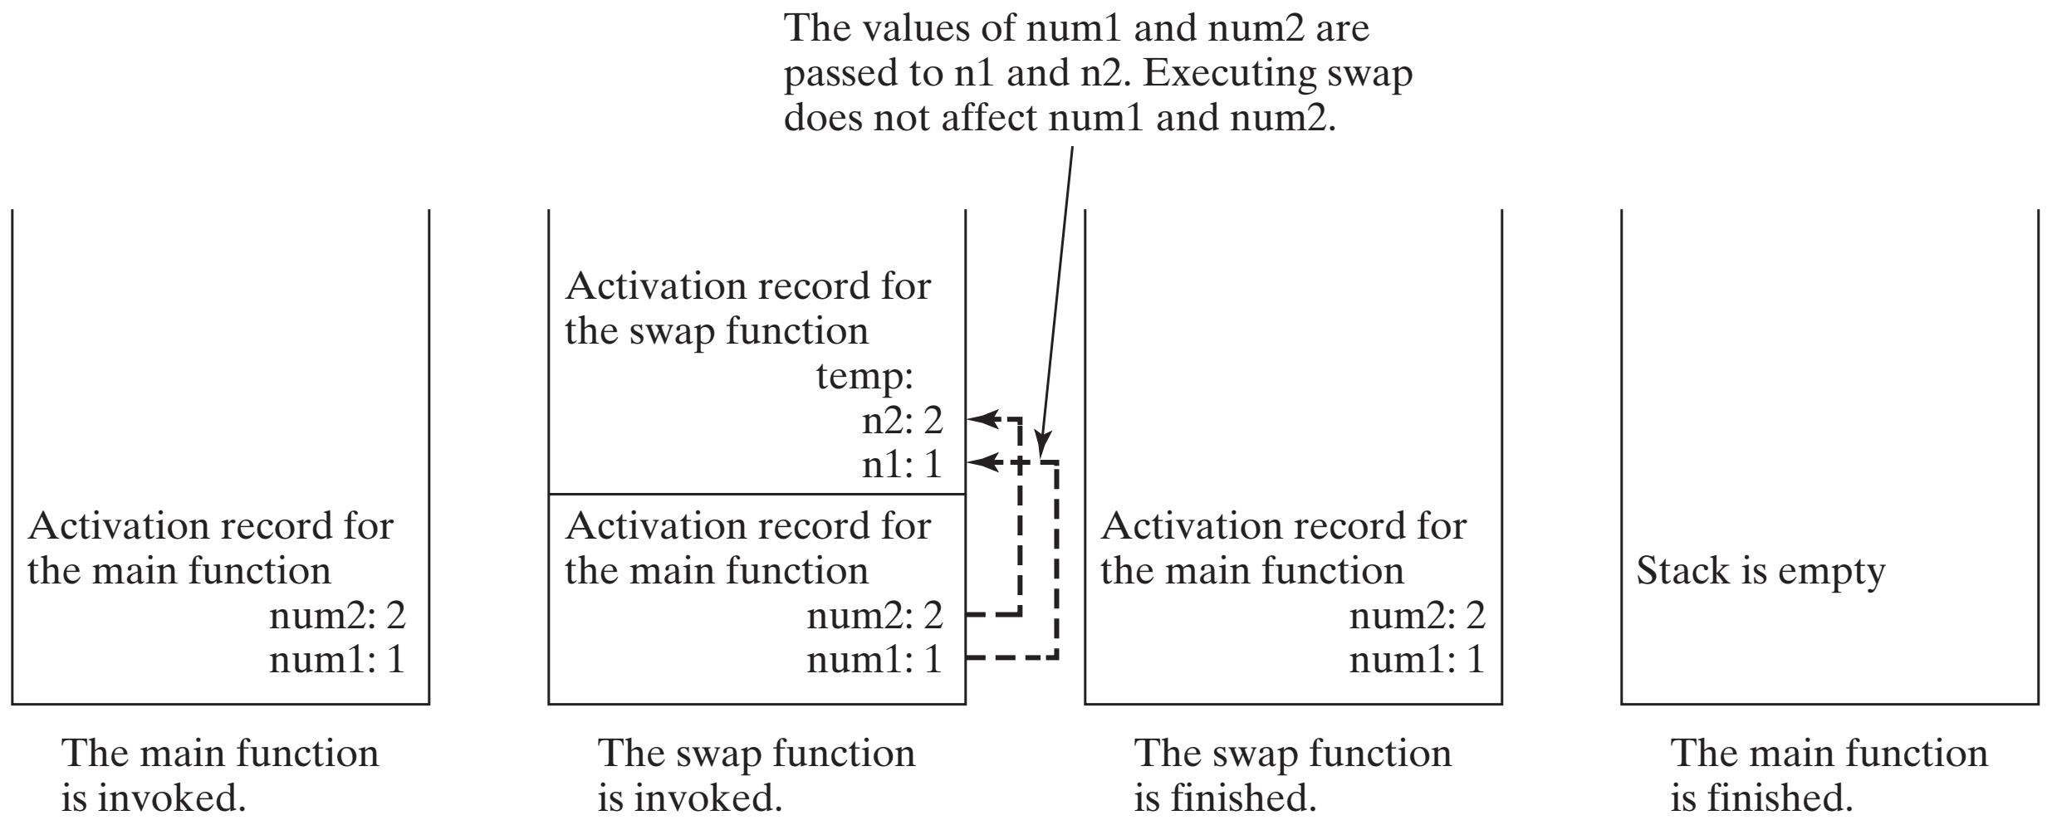
Pass by Value, cont.

Slide 24
Pass by Reference
Write a program for swapping two variables.
void swap(int& n1, int& n2)
{
int temp = n1;
n1 = n2;
n2 = temp;
}
int main()
{
int num1 = 1;
int num2 = 2;
swap(num1, num2);
cout << "After invoking the swap function, num1 is "
<< num1 << " and num2 is " << num2 << endl;
return 0;
}
After invoking the swap function, num1 is 2 and num2 is 1
96

Slide 25
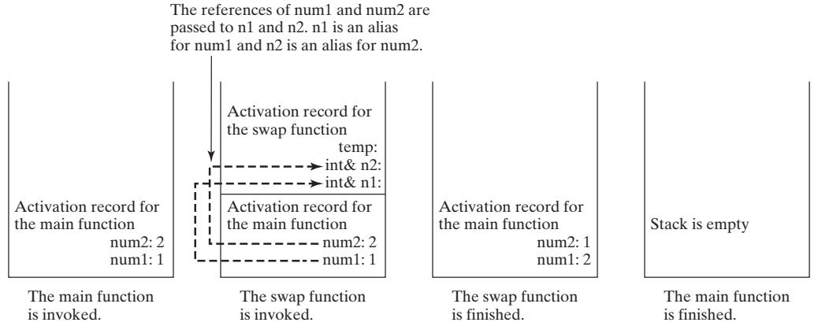
Pass by Reference, cont.

Slide 26
Reference Variables Example
int main()
{
int count = 1;
int& r = count;
cout << "count is " << count << endl;
cout << "r is " << r << endl;
r++;
cout << "count is " << count << endl;
cout << "r is " << r << endl;
count = 10;
cout << "count is " << count << endl;
cout << "r is " << r << endl;
return 0;
}
count is 1
r is 1
count is 2
r is 2
count is 10
r is 10

Slide 27
Pass Arrays as Function Parameters
You can also pass arrays to a function:
void myFunction(int x [5]) {
for (int i = 0; i < 5; i++) {
cout << x [i] << "\n";
}
}
int main() {
int numbers[5] = {10, 20, 30, 40, 50};
myFunction(numbers);
return 0;
}

Slide 28
Scope of Variables
A local variable: a variable defined inside a function.
Scope: o where in the program the variable can be referenced.
o starts from its declaration to the end of the containing block.
You can declare a local variable with the same name in different blocks.
void function1()
{
⋮
for (int i = 1; i < 10; i++)
{
⋮
for (int j = 10; j > 0; j--)
{
⋮
}
⋮
}
}
The scope of i
The scope of j
Notes:
Here

Slide 29
Scope of Local Variables, cont.

Slide 30
Global Variables
Global variables:
Declared outside all functions and are accessible to all functions in its scope.
Defaulted to zero if not directly assigned.

Slide 31
Global Variables
#include <iostream>
using namespace std;
void t1(); // Fnc prototype
void t2(); // Fnc prototype
int main()
{
t1();
t2();
return 0;
}
int y;
void t1()
{
int x = 1;
cout << "x is " << x << endl << "y is " << y << endl;
x++; y++;
}
void t2()
{
int x = 1;
cout << "x is " << x << endl << "y is " << y << endl;
}
A)
x is 1
y is 0
x is 2
y is 1
B)
x is 1
y is 0
x is 2
y is 2
// Global variable, default to 0
C)
x is 1
y is 0
x is 1
y is 1
D)
x is 1
y is 0
x is 1
y is 2

Slide 32



